Slide 1
Week 1
Modelling Data and Entity Relationship Diagrams – Part 1

Slide 2
Student Objectives
Upon completion of this video, you should be able to:
List 2 of the steps required to build the requirements for a large system
Give the name of the model that we will use to visually represent our database for our mini-world
Give the name of the person who invented the visual model used for representing database
List at least 2 different pieces of software you could use to create the visual model

Slide 3
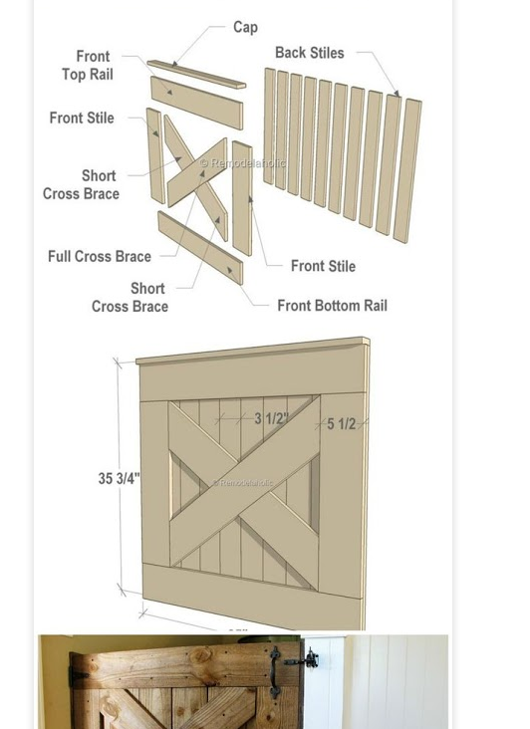
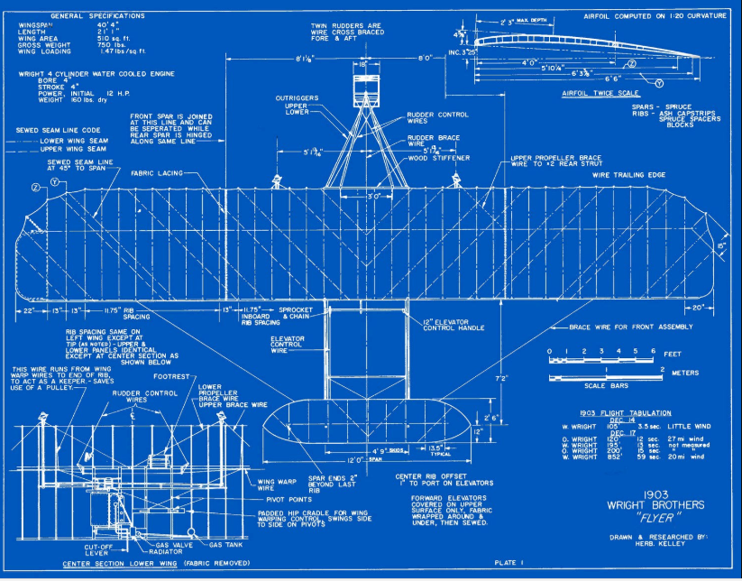
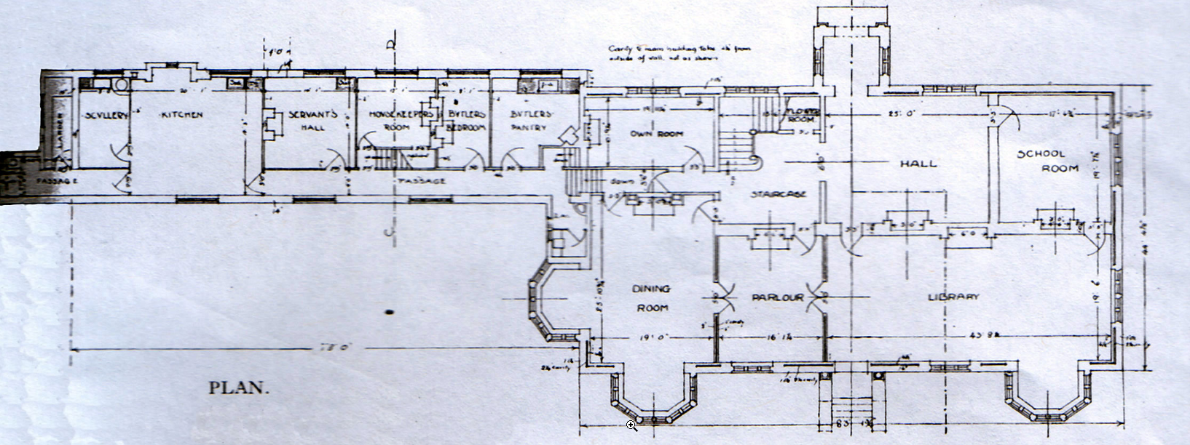
WHY?
QUESTION → What do you do before starting to build anything big…like a house or an airplane or car?
Before creating the database… BUILD A MODEl!

Slide 4
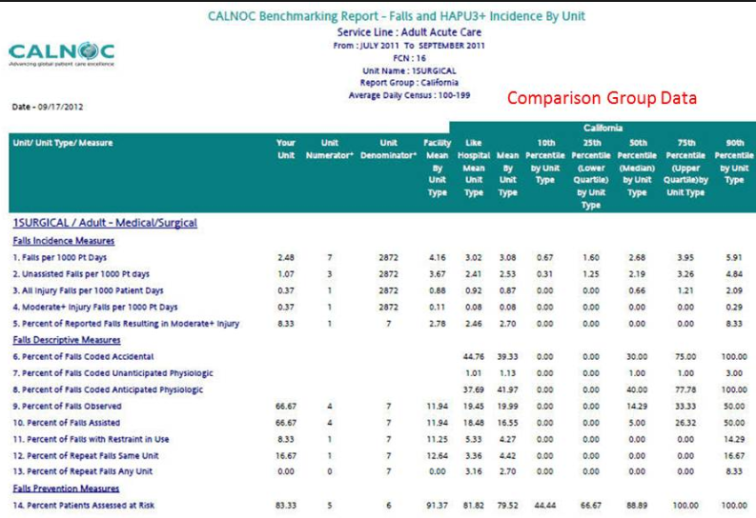
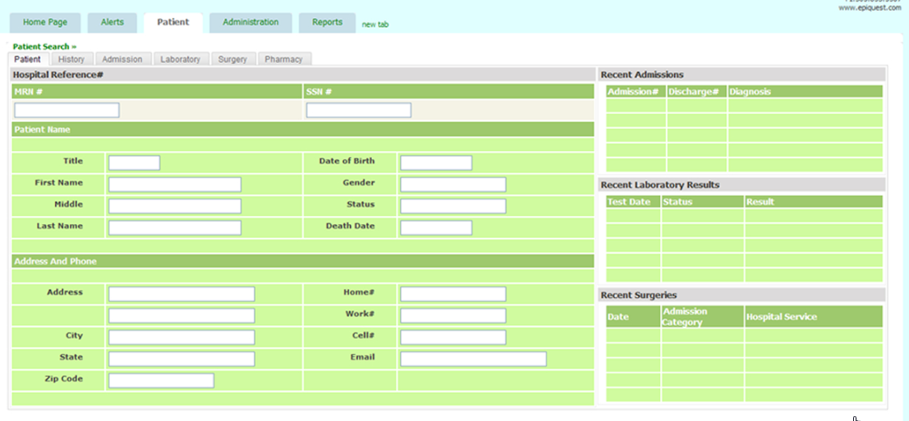
Where and how do we start?
Forget what you learned in first year and second year about coding right away…ALWAYS START WITH THE DATA NOT THE CODE!
Narrow your scope as much as possible and figure out what data you need to store/save by:
Gather any/all reports your customers use/print/generate
Look at any screens where the customers enter/modify data
Find the requirements of your customers/stateholders
Figure how they VIEW the data
Integrate the views to get the minimal data that you need to store (narrowing your scope)

Slide 5
Draw a Model BEFORE creating the database!
Entity Relationship Model (ER Diagram)
Created by Peter Chen in 1976
VISUAL representation of your data
Map your ER Diagram/Model to a currently used model for implementing a database (we will map to the Relational Model)

Slide 6
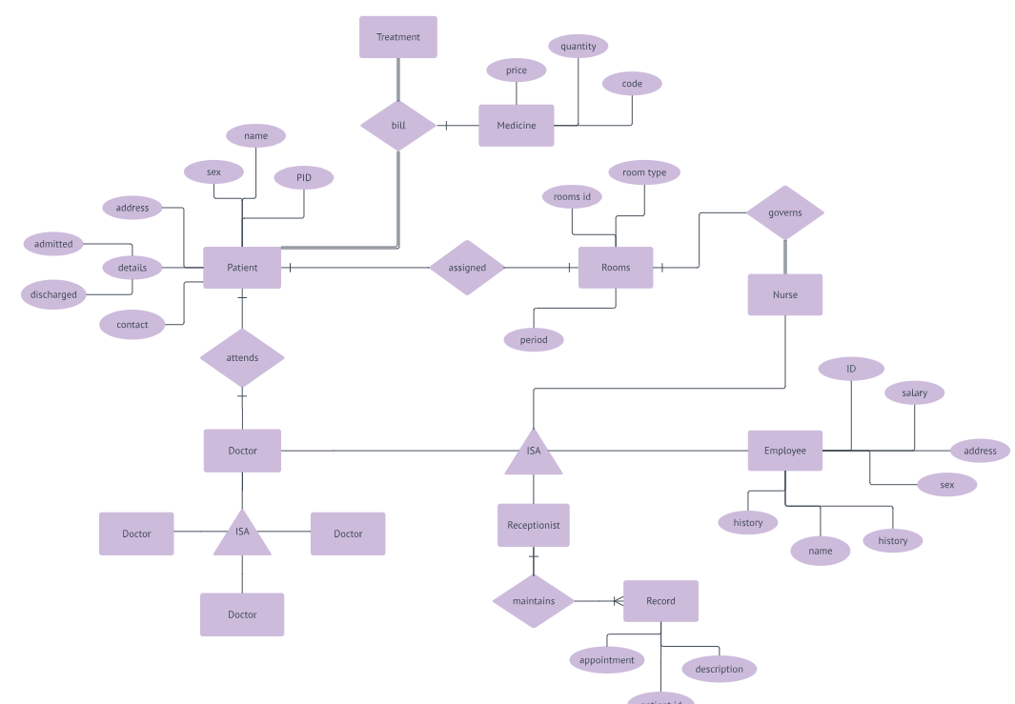
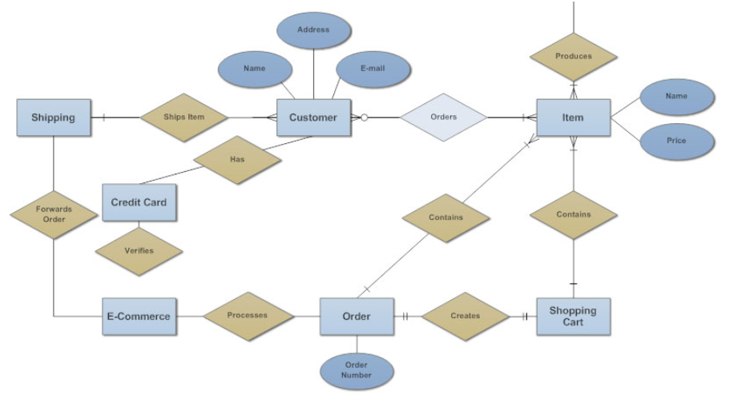
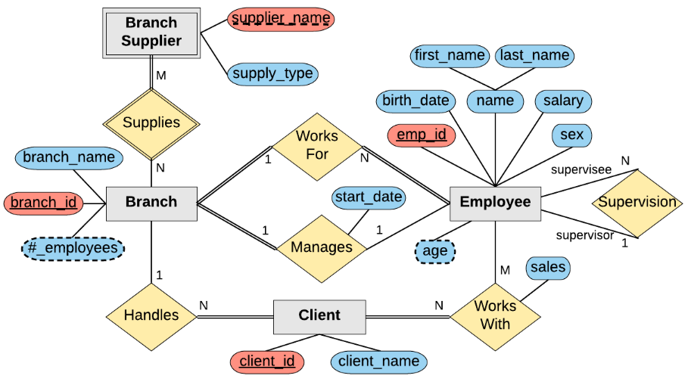
Examples of ER Diagrams:

Slide 7
Case Study – Creating an ER Diagram
Suppose we plan to model a company which is organized into departments.
Each department has a unique name, number and employee who manages it (we want to keep track of when the employee started managing the department)
A department may have several locations
A department controls a bunch of projects, each project has a unique number, name and a single location
Each employee has a name, ssnumber, address, salary, sex and birthdate
An employee is assigned to only one department but may work on several projects which are not necessarily from the same department
Keep track of the number of hours each employee works on each project.
Keep track of the direct supervisor of each employee
Keep track of the dependents of each employee (name, sex, birthdate and relation)

Slide 8
How can we represent the previous slide as a model?
We must incorporate all the information of the mini-world we described!
We will represent it visually
Several programs you could use to create ER Diagrams, for example:
Microsoft Visio → https://support.office.com/en-us/article/video-what-is-visio-421b0c94-7ecf-4e62-8072-d27e04d24fe6
Draw IO → https://www.draw.io/
smartdraw → https://cloud.smartdraw.com/
Lots of other ones!

